Slide 1
Sequence Generation

Slide 2
Matlab commands
exp, sin, cos, square, sawtooth

Slide 3
Several examples
Generation of complex exponential sequence
(program 2_1)
Random noise generation (program 2_1)

Slide 4
Exercises
Generate the smoothed output y(n) from the noise corrupted signal x(n) using the moving average system. (program 2_4)

Slide 5
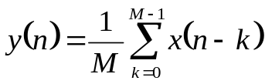

Notes:
M points smoothing average filter:
where,
signal
noise
Matlab commands: plot , filter, xlabel, ylabel

Slide 6
Fourier Series Expansion

Slide 7


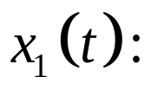



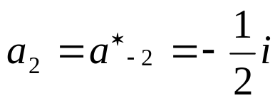



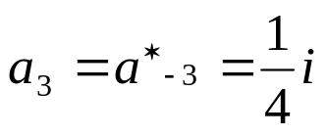
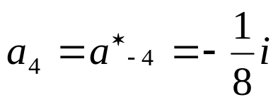
Several Examples
For the given 2N Fourier series parameters and the period T, determine the period signal.
Based on the above example, determine the corresponding period signals.

Slide 8
Several Examples
For the given period signal, please determine the Fourier series parameters.
1
-4
-1
0
T₁=1
T=4
t

Slide 9
The Sampling Process

Slide 10






Several Examples
The three continuous-time signals
of frequencies 3 Hz, 7 Hz, and 13 Hz, are sampled at a sampling rate of 10 Hz, i.e. with T = 0.1 sec. generating the three sequences

Slide 11
Several Examples
Plots of these sequences (shown with circles) and their parent time functions.
What results can you obtain? Give your explanation.

Slide 12
Fourier Transform

Slide 13
Matlab commands
DTFT
  freqz, abs, angle, real, imag
DFT
  fft, fftshift, ifft

Slide 14
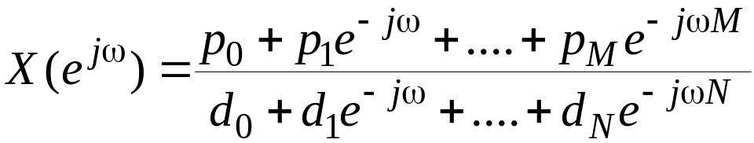
Matlab commands
The function freqz can be used to compute the values of the DTFT of a sequence, described as a rational function in the form of
at a prescribed set of discrete frequency points ω=ω_{λ}

Slide 15
Matlab commands
For example, the statement
H = freqz(num, den, w)
returns the frequency response values as a vector H of a DTFT defined in terms of the vectors num and den containing the coefficients {p_{i}} and {d_{i}}, respectively at a prescribed set of frequencies between 0 and 2p given by the vector w

Slide 16
Matlab commands
There are several other forms of the function freqz
The Program 3_1 (p.128) in the text can be used to compute the values of the DTFT of a real sequence
It computes the real and imaginary parts, and the magnitude and phase of the DTFT

Slide 17
Matlab commands
The functions to compute the DFT and the IDFT are FFT and IFFT
These functions make use of FFT algorithms which are computationally highly efficient compared to the direct computation
Programs 3_2(p.134) and 3_4(p.136) illustrate the use of these functions

Slide 18

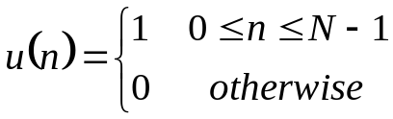
Several examples
Determine the DTFT values of a real sequence described as a rational function . (program 3_1)
Determine the M-point DFT U(k) of the following N-point sequence
(program 3_2)

Slide 19
Exercises
Linear convolution using DFT (program 3_5)

Slide 20
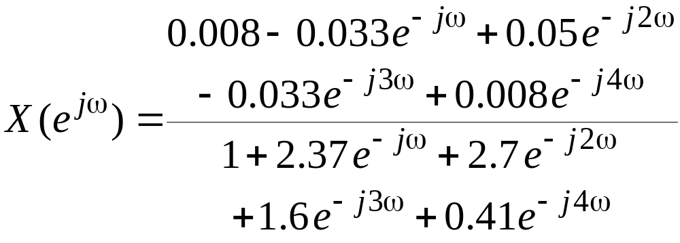
Exercises
Plots of the real and imaginary parts, and the magnitude and phase of the DTFT

Slide 21
Exercises
Compute the DFT and the DTFT of the sequence

Slide 22
LTI discrete time system and frequency response

Slide 23
Matlab commands
Freqz, angle, abs
grpdelay, impz, sinc, zplane, filter

Slide 24
Matlab commands
The function freqz(h,w) can be used to determine the values of the frequency response vector h at a set of given frequency points w
From h, the real and imaginary parts can be computed using the functions real and imag, and the magnitude and phase functions using the functions abs and angle

Slide 25
Several examples
Impulse Response of Truncated Ideal Lowpass Filter (labotatory p 4_1)
Four Types of Linear Phase FIR Filters and Zero Locations of the Filters (labotatory p 4_3)

Slide 26
Exercises (matlab laborary p48-4.1)
Compute and plot the magnitude and phase spectra of a moving average filter which can be described as
  The types of symmetries exhibited by the magnitude and phase spectra
  The type of filter represented by the moving average filter
  The group delay of the filter
  The pole-zero plot of the filter

Slide 27
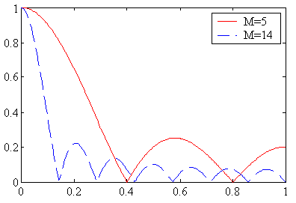
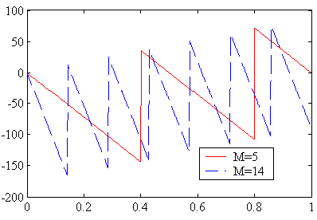
Exercises
Program 4_1(p.206) can be used to generate the magnitude and gain responses of an M-point moving average filter as shown below

Slide 28
Exercises
The phase response of a discrete-time system when determined by a computer may exhibit jumps by an amount 2p caused by the way the arctangent function is computed
The phase response can be made a continuous function of w by unwrapping the phase response across the jumps

Slide 29
Exercises
To this end the function unwrap can be used, provided the computed phase is in radians
The jumps by the amount of 2p should not be confused with the jumps caused by the zeros of the frequency response as indicated in the phase response of the moving average filter

Slide 30
Digital Filter Design

Slide 31
Matlab commands
Blackman, chebwin,hanning, hanmming,kaiser
butter, buttord, cheblord, cheb2ord, cheby1,cheby2
fir1,fir2, remez,remezoprd

Slide 32
Several examples
A known signal
Design a lowpass filter, bandpass filter and highpass
filter respectively, and then filter the above signal.

Slide 33
Several examples
Design a Type 1Chebycheff IIR highpass filter with normalized passband edge at 0.7Hz, normalized stopband edge at 0.5Hz, passband ripple of 1 dB, and minimum stopband attenuation of 32 dB. The sampling frequency is assumed to be 2 Hz. (program 7_2)
Design an IIR butterworh bandpass filter with the following specifications:
normalized passband edges at 0.45 and 0.65, normalized stopband edges at 0.3 and 0.75, passband ripple of 1dB, and minimum stopband attenuation of 40 dB (program 7_3)

Slide 34



Several examples
Determine the transfer function and plot the gain response of an equaripple linear-phase FIR lowpass filter with the same specifications as given in Example1,i.e.
passband edge Fp=800Hz, stopband edge Fs=1000Hz, passband rippple
, minimum stopband attenuation ,and sampling frequency
(program 7_6)

Slide 35

Several examples
Consider the determination of the coefficients and gain response of a Kaiser window to be used for the design of a lowpass FIR filter. The filter specifications are ,
Design the lowpass filter using the Kaiser window
(program 7_7 and program 7_8 )

Slide 36
Exercises

Slide 37
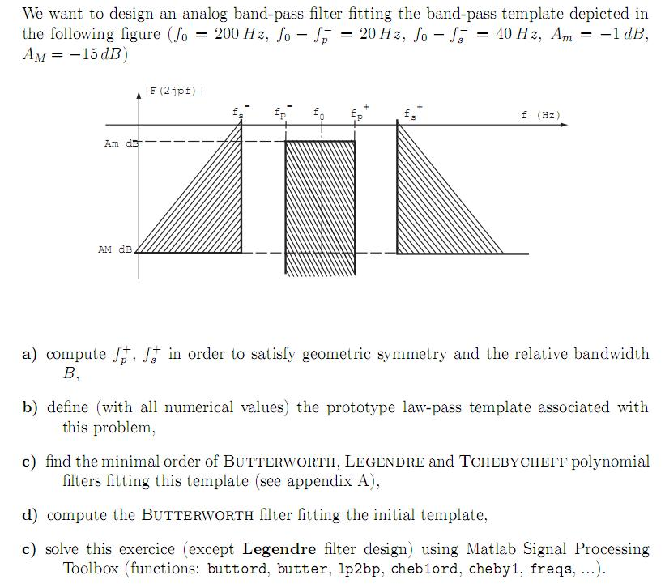

Slide 38
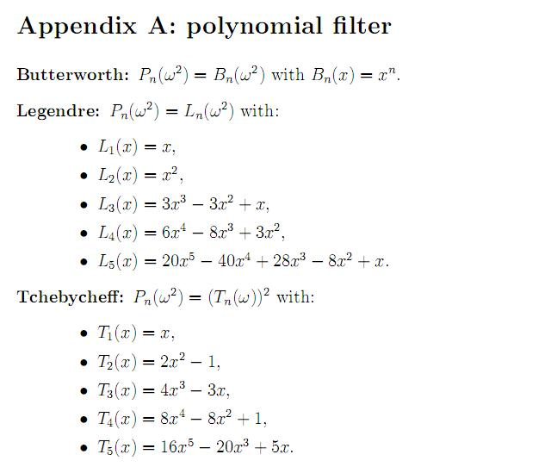

Slide 39
